Slide 1
Lesson Objectives
Understand what a GIS is
Understand how a GIS functions
Understand how spatial data is
represented in a GIS
Look at some GIS applications

Slide 2
Data vs. Information
Data, by itself, generally differs from
information.
Data is of little use unless it is transformed
into information.
Information is an answer to a question
based on raw data.
We transform data into information
through the use of an Information System or Geoinformatics.

Slide 3
INFORMATION SYSTEM OVERVIEW

Slide 4
What is an Information System?
SYSTEM USED FOR:
capturing
storing
updating
manipulating
analyzing
DATA
Notes:
An information system is designed to efficiently capture, store, update, manipulate, analyze, and display DATA.
Remember: Data is NOT Information

Slide 5
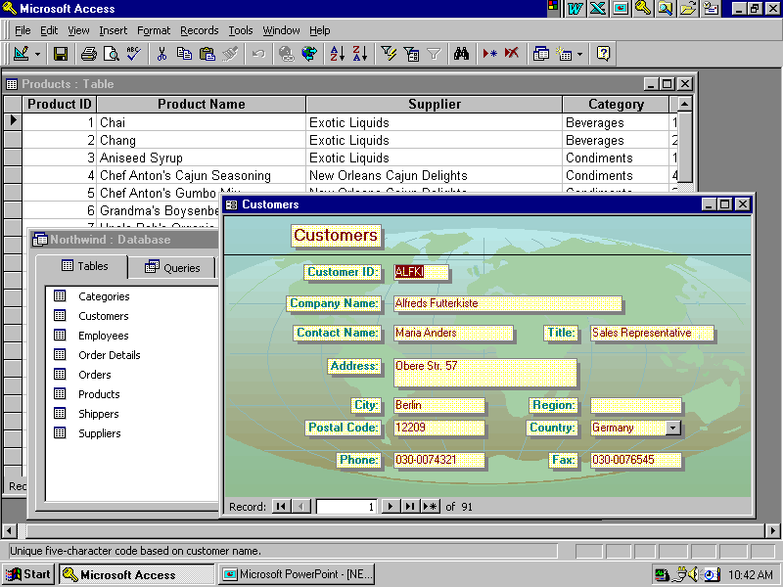
What is an Information System?
In the digital environment we use software to create complex information systems.
Database
Management
Notes:
Some software is optimized for manipulating databases. MS Access is an example of this. Modern database management programs utilize a relational database. This is a database that references each piece of information once and then keeps track of the relationships among them. In this way

Slide 6
What is a GIS?
Information System
A means of storing,
retrieving, sorting,
and comparing
spatial data
to support some
analytic process.
+
Geographic Position
Notes:
A GIS can be best defined by defining the two parts of the term; geography and information system.
Geography is a science that deals with the earth and life on the earth, while an information system is a way to capture, store, retrieve, sort, and process data to support some analytic process.

Slide 7
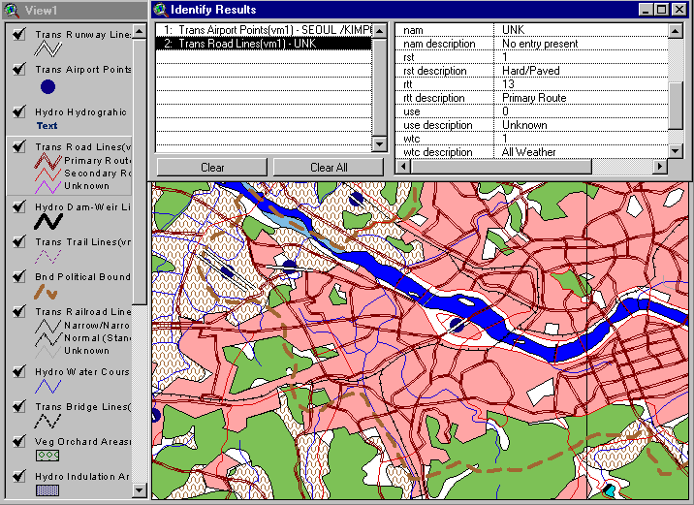
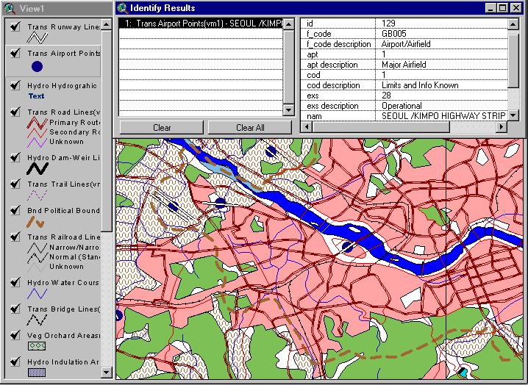
What is a GIS?
GEOGRAPHIC Information System
GIS links graphical features (entities) to tabular data (attributes)
Notes:
What makes the Information System geographic?
The user needs to begin spatially!

Slide 8
GIS Definition
A GIS is a system (hardware + database engine) that is designed to efficiently, assemble, store, update, analyze, manipulate, and display geographically referenced information (data identified by their locations).
A GIS also includes the people operating the system and the data that go into the system.
Notes:
A geographic information system (GIS) is a computer-based tool for mapping
and analyzing things that exist and events that happen on Earth. GIS technology integrates common database operations such as query and statistical analysis with the unique visualization and geographic analysis benefits offered by maps. These abilities distinguish GIS from other information systems and make it valuable to a wide range of public, military and private enterprises for explaining events, predicting outcomes, and planning strategies. Whether siting a military base camp, finding the best soil for a tank to maneuver on, or figuring out the best low level air route for a bombing raid. Map making and geographic analysis are not new, but a GIS performs these tasks better and faster than do the old manual methods. And, before GIS technology, only a few people had the skills necessary to use geographic information to help with decision making and problem solving. Today, GIS is a multi-billion-dollar industry employing hundreds of thousands of people worldwide. GIS is taught in schools, colleges, and universities throughout the world. Professionals in every field are increasingly aware of the advantages of thinking and working geographically.

Slide 9
Knowledge Base for GIS
Computer
Science/MIS
graphics
visualization
database
system administration
security
Application Area:
public admin.
planning
geology
mineral exploration
forestry
site selection
marketing
civil engineering
criminal justice
surveying
GIS
Geography
and related:
cartography
geodesy
photogrammetry
landforms
spatial statistics.
The convergence of technological fields and traditional disciplines.

Slide 10
Key Functions of a GIS
Data can be:
Positioned by its known spatial coordinates.
Input and organized (generally in layers).
Stored and retrieved.
Analyzed (usually via a Relational DBMS).
Modified and displayed
Notes:
A geographic information system (GIS) is a computer-based tool for mapping
and analyzing things that exist and events that happen on Earth. GIS technology integrates common database operations such as query and statistical analysis with the unique visualization and geographic analysis benefits offered by maps. These abilities distinguish GIS from other information systems and make it valuable to a wide range of public, military and private enterprises for explaining events, predicting outcomes, and planning strategies. Whether siting a military base camp, finding the best soil for a tank to maneuver on, or figuring out the best low level air route for a bombing raid. Map making and geographic analysis are not new, but a GIS performs these tasks better and faster than do the old manual methods. And, before GIS technology, only a few people had the skills necessary to use geographic information to help with decision making and problem solving. Today, GIS is a multi-billion-dollar industry employing hundreds of thousands of people worldwide. GIS is taught in schools, colleges, and universities throughout the world. Professionals in every field are increasingly aware of the advantages of thinking and working geographically.

Slide 11
Geographic Information Systems
Define problem
Define problem
Decision
Decision
GIS
Process
GIS
Process
Define GIS criteria
Output
Define GIS criteria
Output
Import or build datasets
GIS analysis
Import or build datasets
GIS analysis
Notes:
GIS PROCESS:
The GIS process involves six steps that are common to what we refer to as the end to end map-making process.
1. Define the spatial problem/question.
.Define the GIS criteria.
.Import or create the data sets
.Perform the GIS analysis
.Create the output
.Decide whether or not the output solves or answers the spatial problem/question. If not, then refine the problem and start the process again.

Slide 12
Geoinformatics Appilcations
Urban Planning, Management & Policy
Zoning, subdivision planning
Land acquisition
Economic development
Code enforcement
Housing renovation programs
Emergency response
Crime analysis
Tax assessment
Environmental Sciences
Monitoring environmental risk
Modeling stormwater runoff
Management of watersheds, floodplains, wetlands, forests, aquifers
Environmental Impact Analysis
Hazardous or toxic facility siting
Groundwater modeling and contamination tracking
Political Science
Redistricting
Analysis of election results
Predictive modeling
Civil Engineering/Utility
Locating underground facilities
Designing alignment for freeways, transit
Coordination of infrastructure maintenance
Business
Demographic Analysis
Market Penetration/ Share Analysis
Site Selection
Education Administration
Attendance Area Maintenance
Enrollment Projections
School Bus Routing
Real Estate
Neighborhood land prices
Traffic Impact Analysis
Determination of Highest and Best Use
Health Care
Epidemiology
Needs Analysis
Service Inventory
Notes:
7

Slide 13
What is ArcGIS?
E X T E N S I O N S
ArcGIS Desktop
ArcGIS Engine
E X T E N S I O N S
ArcInfo
Custom Application
ArcGIS Clients
ArcEditor
ArcView
ArcReader
ArcPad
Web Browser
Components
ArcObjects
Network
ArcGIS Server
ArcIMS
Application/Data Servers
ArcSDE
RDBMS
Notes:
ArcGIS is the name used to identify ESRI’s flagship family of GIS products. ArcGIS® includes ArcGIS client software, components as well as application and data server software. ArcGIS itself is not a GIS application; rather, it is a set of software products for building ArcGIS systems that best suit your GIS needs.
ArcGIS is based on a common library of shared GIS software components, called ArcObjects™.
ArcGIS is composed of client and server applications. Each software application can create, manage, analyze, and serve data stored in one or more formats.
ArcGIS Desktop: Integrated suite of advanced GIS applications consisting of three software products: ArcView®, ArcEditor™, and ArcInfo®. The ArcGIS Desktop applications provide the same core mapping, editing, and analysis functionality. The level of functionality available differs depending on which license you have. ArcInfo provides users with the most complete level of GIS functionality. It is composed of ArcInfo Desktop, as well as ArcInfo Workstation.
ArcReader™: Allows users to view high quality published maps (.PMFs) created in ArcMap™.
ArcGIS® Engine: Developer toolkit of embeddable GIS components for building custom stand alone applications using COM, C++, Java, and .NET
ArcPad®: Used with PDAs for creating and managing data while in the field
ArcGIS® Server: A shared library of GIS software objects used to build/develop serverside GIS applications in enterprise and Web computing frameworks
ArcIMS®: Use to publish maps, data, and metadata through open internet protocols
ArcSDE®: Manages and serves spatial information from external RDBMS to ArcGIS clients
For more information, go to http://www.esri.com/software/index.html.

Slide 14
ArcGIS Desktop Products
ArcInfo
ArcEditor
ArcView
Increased Functionality

Slide 15
The history of ESRI products
ArcCatalog
ArcInfo
ArcView
ArcGIS
ArcInfo
ArcView
ArcEditor
time

Slide 16
Spatial Data Collection
http://bhuvan.nrsc.gov.in/data/download/index.php (For India)
http://earthexplorer.usgs.gov/ (For USA)
EOLISA (For European)
Survey of India Topographical Sheets
Others like District Resource Maps

Slide 17
Spatial Data Mining (SDM)
Search for spatial patterns.
Non-trivial search – as “automated” as possible.
Large search space of plausible hypothesis
Ex. Asiatic cholera : causes water, food, air, insects.
Interesting, useful, and unexpected spatial patterns.
Useful in certain application domain
Ex. Shutting off identified water pump => saved human lives.
May provide a new understanding of the world
Ex. Water pump – Cholera connection lead to the “germ” theory.
Spatial data mining is the process of discovering interesting, useful, non-trivial patterns from large spatial datasets

Slide 18
What is NOT Spatial Data Mining?
Simple querying of Spatial Data
Finding neighbors of Canada given names and boundaries of all countries (Search space not large)
Uninteresting or obvious patterns
Heavy rainfall in Minneapolis is correlated with heavy rainfall in St. Paul (10 miles apart).
Common knowledge, nearby places have similar rainfall
Mining of non-spatial data
Tea and Snack sales are correlated in evenings

Slide 19
What is Spatial Pattern?
What is not a pattern?
Random, haphazard, chance, stray, accidental, unexpected
Without definite direction, trend, rule, method, design, aim, purpose
Accidental - without design, outside regular course of things
Casual - absence of pre-arrangement, relatively unimportant
Fortuitous - What occurs without known cause
What is a Pattern?
A frequent arrangement, configuration, composition, regularity
A rule, law, method, design, description
A major direction, trend, prediction
A significant surface irregularity or unevenness

Slide 20
Families of Spatial Data Mining Patterns
Location Prediction:
Where will a phenomenon occur?
Spatial Interactions
Which subset of spatial phenomena interact?
Hot spot
Which locations are unusual or share commonalities?

Slide 21
Location Prediction
Where will a phenomenon occur?
Which spatial events are predictable?
How can a spatial event be predicted from other spatial events?
Examples
Where will an endangered bird nest?
Which areas are prone to fire given maps of vegetation and drought?
What should be recommended to a traveler in a given location?

Slide 22
Spatial Interactions
Which spatial events are related to each other?
Which spatial phenomena depend on other phenomenon?
Examples
Earth science:
climate and disturbance => {wild fires, hot, dry, lightning}
Epidemiology:
Disease type and enviornmental events => {West Nile disease, stagnant water source, dead birds, mosquitoes}

Slide 23
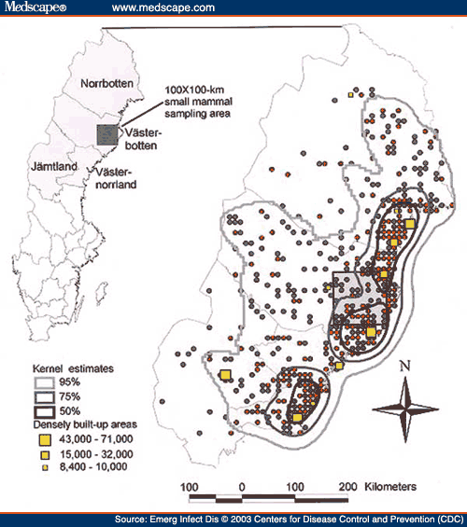
Hot spots
Is a phenomenon spatially clutered?
Which spatial entities are unusual or share common characteristics?
Examples
Crime hot spots to plan police patrols

Slide 24
SDM will be continued in next lecture….. Take a break for 10 minutes and we will meet again for laboratory work

Slide 25
Today’s Task in Computer Laboratory
Read: “What is ArcGIS version??”
“Exploring the ArcGIS interface”
“ArcGIS GUI”
“ArcGIS modules”
Perform in simulation laboratory:
Register on Bhuvan (get a user id and password)
Download Cartosat DEM image from Bhuvan over Varanasi
Download LISS III image from Bhuvan over Varanasi

Slide 26
Characteristics of Spatial Data Mining
Auto correlation
Patterns usually have to be defined in the spatial attribute subspace and not in the complete attribute space
Longitude and latitude (or other coordinate systems) are the glue that link different data collections together
People are used to maps in GIS; therefore, data mining results have to be summarized on the top of maps
Patterns not only refer to points, but can also refer to lines, or polygons or other higher order geometrical objects
Large, continuous space defined by spatial attributes
Regional knowledge is of particular importance due to lack of global knowledge in geography (→spatial heterogeniety)

Slide 27
Why Regional Knowledge Important in Spatial Data Mining?
A special challenge in spatial data mining is that information is usually not uniformly distributed in spatial datasets.
It has been pointed out in the literature that “whole map statistics are seldom useful”, that “most relationships in spatial data sets are geographically regional, rather than global”, and that “there is no average place on the Earth’s surface” [Goodchild03, Openshaw99].
Therefore, it is not surprising that domain experts are mostly interested in discovering hidden patterns at a regional scale rather than a global scale.

Slide 28
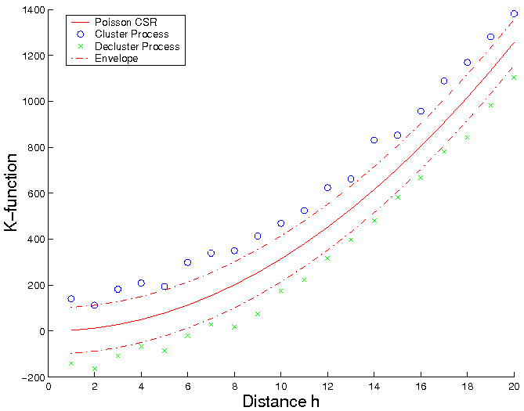
Spatial Autocorrelation: Distance-based measure
K-function Definition
Test against randomness for point pattern
λ is intensity of event
Model departure from randomness in a wide range of scales
Inference
For Poisson complete spatial randomness (CSR): K(h) = πh²
Plot Khat(h) against h, compare to Poisson CSR
>: cluster
<: decluster/regularity
[number of events within distance h of an arbitrary event]
K-Function based Spatial Autocorrelation

Slide 29
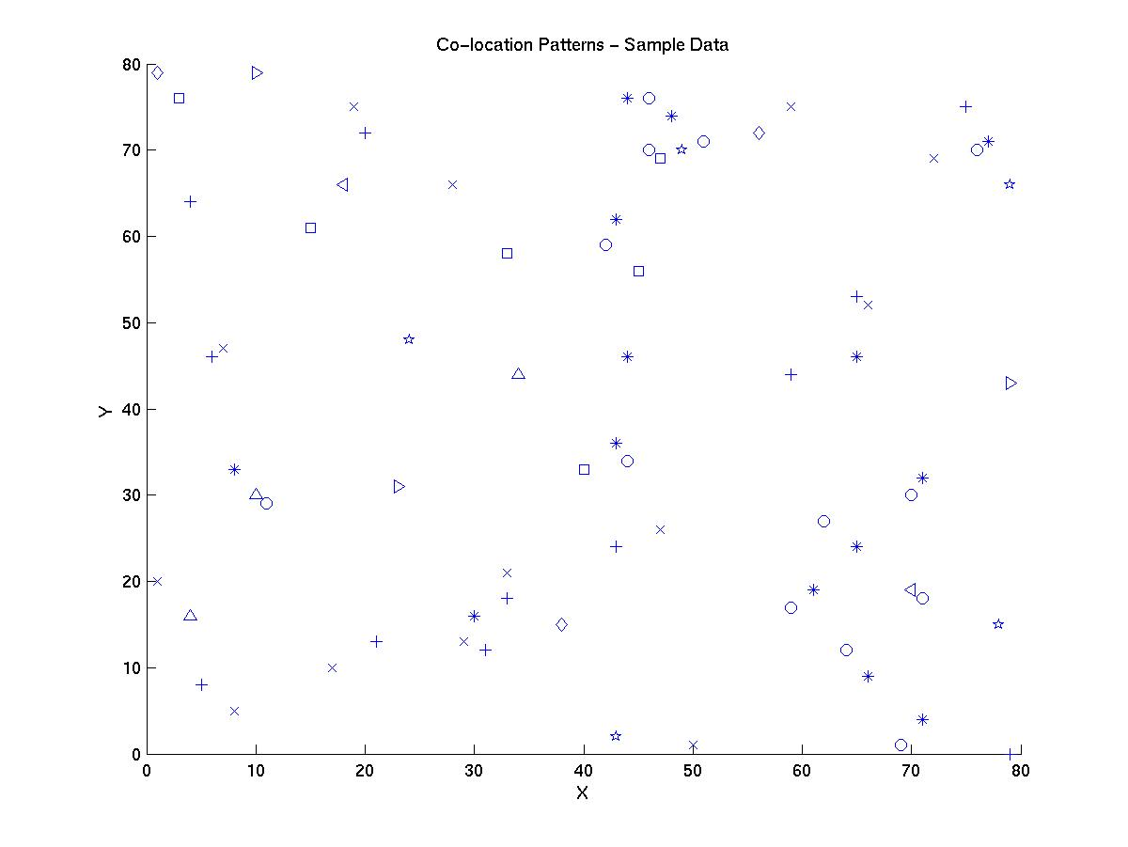

Associations, Spatial associations, Co-location
Answers: and
Find patterns from the following sample dataset?

Slide 30
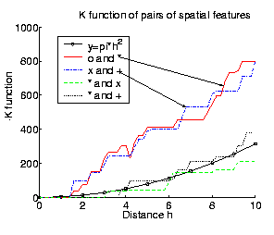
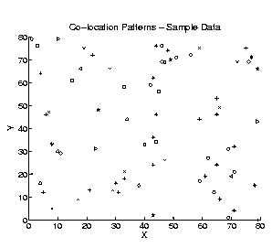
Colocation Rules – Spatial Interest Measures

Slide 31
Conclusions Spatial Data Mining
Spatial patterns are opposite of random
Common spatial patterns: location prediction, feature interaction, hot spots, geographically referenced statistical patterns, co-location, emergent patterns,…
SDM = search for unexpected interesting patterns in large spatial databases
Spatial patterns may be discovered using
Techniques like classification, associations, clustering and outlier detection
New techniques are needed for SDM due to
Spatial Auto-correlation
Importance of non-point data types (e.g. polygons)
Continuity of space
Regional knowledge; also establishes a need for scoping
Separation between spatial and non-spatial subspace—in traditional approaches clusters are usually defined over the complete attribute space
Knowledge sources are available now
Raw knowledge to perform spatial data mining is mostly available online now (e.g. relational databases, Google Earth)
GIS tools are available that facilitate integrating knowledge from different source

